Slide 1
INTRODUCTION
- JAVA (Part 2)
(Module 1)-
Prepared by Renetha J.B.
Prepared by Renetha J.B.

Slide 2
Topics
Introduction to Java
Structure of a simple java program
Java programming Environment and Runtime Environment,
Java compiler
JVM
Prepared by Renetha J.B.

Slide 3

Java
Developed by James Gosling from Sun Microsystems in 1991.
  This language was initially called “Oak,” and was renamed “Java” in 1995.
The target of Java is to Write a program Once and then Run this program Anywhere (multiple operating systems). (WORA)
Java is a compiled-interpreted programming language
Prepared by Renetha J.B.

Slide 4
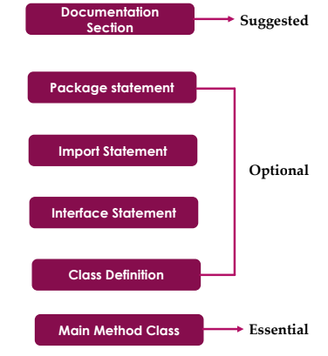

Structure of a simple Java program
Prepared by Renetha J.B.

Slide 5
Structure of java- Documentation Section
We can write comments in this section for documentation.
Comments help to understand the code.
There are three types of comments that Java supports
  Single line Comment
  Multi-line Comment
  Documentation Comment
Prepared by Renetha J.B.

Slide 6
Comments
Single line comment - begins with//
  //This is single line comment
Multi-line Comment – begins with /* and ends with */
  /* this is multiline comment.
  and support multiple lines*/
Documentation Comment
/**
*this is documentation
*comment
*/
Prepared by Renetha J.B.

Slide 7
Structure of java - package statement
A package is a group of classes or interfaces.
Package is declared as:
package package_name;
Eg:
package oop;
We can create a package with any name.
If package statement is not there then program will be in default package
Package statement is optional.
Prepared by Renetha J.B.

Slide 8
Structure of Java- import Statement
If we want to use a class of another package, then we have to import that package directly into our program using import statement.
Syntax
import packagename.*;
import packagename.classname;
Examples:
import java.io.*; // This import all classes from java.io package
import java.util.Date; //This imports the Date class
Prepared by Renetha J.B.

Slide 9
Structure of Java-interface Statement
This statement is used to specify interface in Java.
Interfaces includes a group of method declarations.
It is an optional section
Prepared by Renetha J.B.

Slide 10
Structure of Java-Class Definition
A Java program may contain several class definitions.
Classes are the main and essential elements of any Java program.
A class is a collection of data and methods.
It is a good convention to start every word of class name with capital letter
E.g
class Example
{
}
class IncomeTax
{
}
Prepared by Renetha J.B.

Slide 11
Structure of java- Main Method Class
Every Java stand-alone program requires the main method as the starting point of the program.
  This is an essential part of a Java program.
There may be many classes in a Java program, and only one class defines the main method.
  class Classname
  {
    public static void main(String args[])
    {
    }
    }
}
Prepared by Renetha J.B.

Slide 12
Main function
public static void main(String args[])
{
}
public means it can also be used by code outside of its class. (can be accessed from anywhere)
static is used when we want to access a method without creating its object.
void indicates that a function does not return a value.
main is the function name
String is a class.
  args is an array of instances of String
Prepared by Renetha J.B.

Slide 13
String args[ ]
String args[ ]
We can use any name instead of args. Eg String b[]
If Java program is run through the console, we can pass the input parameters (command line arguments), to main( ) method.
  Then args in main function receives the command-line arguments passed when the program is executed.
String args[ ] can also be written as String[] args
Prepared by Renetha J.B.

Slide 14
Simple Java program
FIRST SIMPLE PROGRAM
/**
*This is a simple Java program.
*Save this file "Example.java".
*/
import java.io.*;
class Example
{
// Your program begins with a call to main().
  public static void main(String args[])
  {
  System.out.println("This is a simple Java program.");
  /* This statement prints
  This is a simple Java program.”);
  */
  }
}
Prepared by Renetha J.B.

Slide 15
This program begins with the following lines:
/**
*This is a simple Java program.
*Save this file "Example.java".
*/
This is a documentation comment.- more than one lines are commented. Lines inside /* and */ are comments
  NOT EXECUTABLE CODES
The contents of a comment are ignored by the compiler. Instead, a comment describes or explains the operation of the program to anyone who is reading its source code.
Prepared by Renetha J.B.

Slide 16
The next line of code in the program is :
import java.io.*;
This statement imports all classes in the java.io package.
During compilation , the compiler will look at those classes.
java.io.* is Input/Output package
Prepared by Renetha J.B.

Slide 17
The next line of code in the program is :
class Example
{
This line uses the keyword class to declare that a new class is being defined.
  Here Example is the identifier that is the name of the class.
The entire class definition, including all of its members, will be between the opening curly brace ({) and the closing curly brace (}).
Prepared by Renetha J.B.

Slide 18
The next line in the program is the single-line comment,
// Your program begins with a call to main().
Prepared by Renetha J.B.

Slide 19
Next line
public static void main(String args[])
This is the main function header
Main function definition
  public static void main(String args[])
  {
  System.out.println("This is a simple Java program.");
  /* This statement prints
  This is a simple Java program.”);
  */
  }
System.out.println("This is a simple Java program.");
  prints the line This is a simple Java program. as output on the screen and control goes to new line
/* This statement prints
  This is a simple Java program.”);
  */
  This is multiline comment. Statements inside /* and */ are not executed. They are comments.

Slide 20
System.out.println();
System.out.println();
This statement is used to print a text on the screen as output .
System is a predefined class.
out is an object of the PrintWriter class defined in the system
The method println() prints the text that is inside the ( ) on the screen and add a new line.
We can also use print() method instead of println() method.(new line will not be added )
All Java statement ends with a semicolon.
Prepared by Renetha J.B.

Slide 21
System.out.println(“Hello world”);
This statement is used in Java program to print
Hello world
System.out.println(“Hello”);
System.out.println(“world”);
These statements in Java program print
Hello
world
System.out.print(“Hello”);
System.out.print(“world”);
These statements in Java program print
Helloworld
Prepared by Renetha J.B.

Slide 22
System.out.print(“Hello\nworld”);
Prepared by Renetha J.B.

Slide 23
Simple Java program
FIRST SIMPLE PROGRAM (without comments)
import java.io.*;
class Example
{
  public static void main(String args[])
  {
  System.out.println("This is a simple Java program.");
  }
}
Prepared by Renetha J.B.

Slide 24
Java Programming Environment
The Java Programming Environment refers to the complete setup that allows developers to write, compile, run, and debug Java programs.
It includes the tools, components, and processes required to develop Java applications.
The main parts of the Java programming environment are:
  JRE (Java Runtime Environment)
  JDK(Java Development Kit)
  JVM (Java Virtual Machine)
  API libraries
  IDE
Prepared by Renetha J.B.

Slide 25
Java RunTime Environment(JRE)
It is an installation package which provides environment to only run (not develop)the java program (or application) onto your machine.
JRE is only used by END-USERS of the system who only wants to run the Java programs
The JDK, along with the Java Virtual Machine (JVM) and the JRE, can be used by developers to program and run Java applications.
Prepared by Renetha J.B.

Slide 26
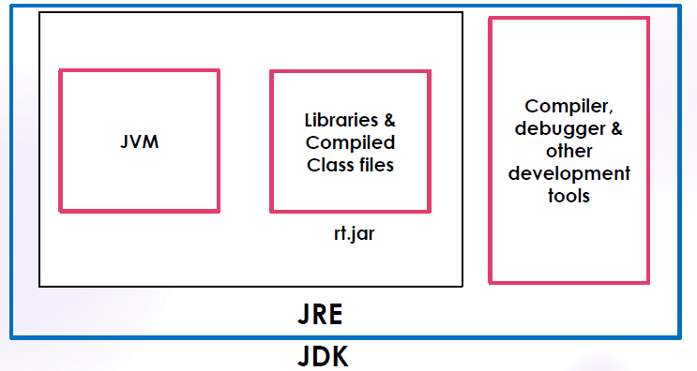
JDK
The Java Development Kit (JDK) is a software development environment used for developing Java applications.
JDK includes
  The Java Runtime Environment (JRE)
  An interpreter/loader (Java)
  A compiler (javac)
  An archive (jar)
  A documentation generator (Javadoc)
  Other tools needed in Java development.

Slide 27
JDK
JDK provides the environment to develop and execute(run)the Java program.
JDK is a kit(or package) which includes two things
  Development Tools(to provide an environment to develop your java programs)
  JRE (to execute your java program).
JDK is used by Java Developers.
Prepared by Renetha J.B.

Slide 28
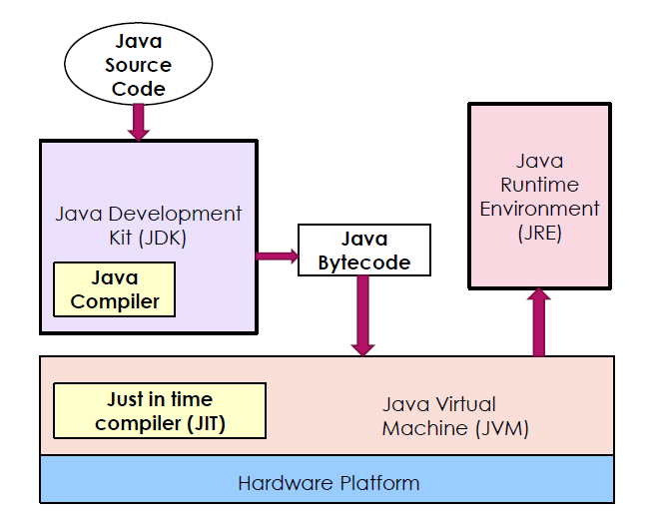
Interaction between JDK and JRE
Prepared by Renetha J.B.

Slide 29
Java Runtime Environment
Command Line
IDE
Prepared by Renetha J.B.

Slide 30
Command Line
Using Java from the Command Line
The command line provides a lightweight way to compile and run.
Prerequisites
Java Development Kit (JDK):
  Ensure JDK is installed (e.g., OpenJDK or Oracle JDK). Verify installation by running:
java -version
javac -version
A text editor (e.g., Notepad, VS Code, or Vim) to write Java code.
Prepared by Renetha J.B.

Slide 31
Using command line
Steps to Compile and Run a Java Program
Write the Java Code: Create a file named HelloWorld.java and type Java program to print Hello World.
Compile the Code: Open a terminal(command line), navigate to the directory containing HelloWorld.java, and compile using:
This generates a HelloWorld.class file if compilation is successful.
Run the Program: Execute the compiled program using:
javac HelloWorld.java
java HelloWorld
Prepared by Renetha J.B.

Slide 32
HelloWorld.java
import java.io.*
class HelloWorld
{
  public static void main(String args[])
  {
  System.out.println(“Hello World.");
  }
}
Prepared by Renetha J.B.

Slide 33
Using command line
Open terminal in Linux
ooplab@user:$ javac HelloWorld.java
ooplab@user:$ java HelloWorld
This is a simple Java program.
Prepared by Renetha J.B.

Slide 34
IDE
IDE is Integrated Development Environment.
An IDE is a software application that helps programmers develop software code efficiently.
It provides a comprehensive environment for writing, editing, compiling, running, and debugging Java code.
Prepared by Renetha J.B.

Slide 35
IDE
IDEs provide a broad variety of features such as:
Editor: helps to write software code by highlighting syntax with visual cues, providing language-specific auto-completion, and checking for bugs as we type.
Compiler
Build-in Terminal
Version Control
Extensions and Plugins
Code navigation
Prepared by Renetha J.B.

Slide 36
IDE
Some of the Java IDE are
  Eclipse
  NetBeans
  VS code
  JDeveloper
  IntelliJ IDEA
Prepared by Renetha J.B.

Slide 37
Command Line | IDE
Text-based interface using tools like javac and java to compile/run Java code. | Graphical tool (e.g., IntelliJ IDEA, Eclipse) integrating coding, debugging, and JRE management.
manual commands (e.g., javac MyProgram.java, java MyProgram). | User-friendly GUI with auto-completion, error highlighting, and one-click run/debug.
Manual JRE/JDK setup (e.g., set JAVA_HOME, PATH); run via java command. | JRE configured in IDE settings (e.g., Project Structure); auto-managed for run/debug.
Basic: compile, run, manual dependency management; debugging via jdb. | Advanced: syntax highlighting, refactoring, integrated debugging, testing
Lightweight, minimal resource usage, ideal for low-spec systems. | Resource-heavy due to GUI and background processes; needs more memory/CPU.
Highly flexible with any text editor; manual control over build/run processes. | Less flexible but highly automated; customizable via plugins/settings.
Small scripts, lightweight setups | Complex projects, beginners, or developers needing robust tools and automation.
Prepared by Renetha J.B.

Slide 38
Java Compiler
A Java compiler is a compiler for Java programming language.
Java programs are compiled using javac command.
Command for compilation
  javac Programname.java
The output of compiling the java code is not executable code. It is called bytecode (Programname.class)
Prepared by Renetha J.B.

Slide 39
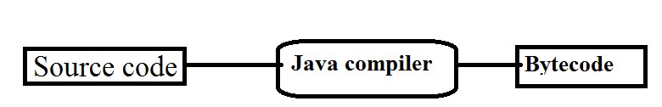
Sample.java Sample.class
Prepared by Renetha J.B.

Slide 40
Java’s Magic: The Bytecode
The output of compiling the java code is not executable code. It is called bytecode.
Bytecode is a highly optimized set of instructions designed to be executed by the Java run-time system, which is called the Java Virtual Machine (JVM).
JVM was designed as an interpreter for bytecode.
Bytecode is a class file.
Prepared by Renetha J.B.

Slide 41
Bytecode(contd.)
Translating a Java program into bytecode makes it much easier to run a program in a wide variety of environments because only the JVM needs to be implemented for each platform. - PORTABILITY
Although the details of the JVM will differ from platform to platform, all JVM understand the same Java bytecode.
Bytecode has been highly optimized, so the use of bytecode enables the JVM to execute programs much faster.(eventhough compilation and interpretation is needed)
Prepared by Renetha J.B.

Slide 42
JVM
JVM is the Java run-time system.
Java Virtual Machine is called virtual because it provides a machine interface that does not depend on the operating system and machine hardware architecture.
So Java programs are WORA (Write Once Run Anywhere)p rograms.
Prepared by Renetha J.B.

Slide 43
JVM(contd.)
When we compile a Java program, we get .class file(bytecode) which is not executable.
JVM interprets the .class file into machine code depending on the operating system and hardware.
JVM executes java programs like a machine.
JVM is also responsible for garbage collection, array bond checking etc.
JVM is platform indepenedent.
Prepared by Renetha J.B.

Slide 44
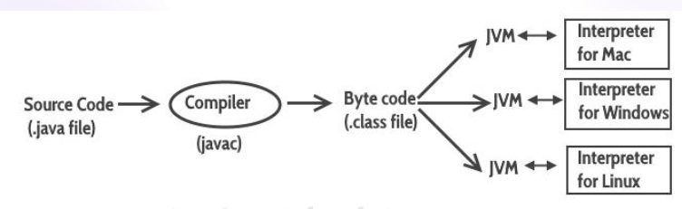
Prepared by Renetha J.B.

Slide 45

JIT compiler
JIT(Just In Time) compiler is part of the JVM,
JIT compiler compiles selected portions of bytecode into executable code in real time, on a piece-by-piece, demand basis.
JIT compiler compiles code as it is needed, during execution.
  Not all sequences of bytecode are compiled
    only codes that will benefit from compilation are compiled.
  The remaining code is simply interpreted.
Thus, Java is a compiled interpreted language.
Prepared by Renetha J.B.

Slide 46
Development Platforms
All Java platforms consist of a Java Virtual Machine (JVM) and an Application Programming interface (API).
  The Java Virtual Machine runs Java technology applications.
  An API is a collection of software components that you can use to create other software components or applications.
Prepared by Renetha J.B.

Slide 47
Development Platforms
Java development platform is a particular environment in which Java programming language applications run.
  Java Platform, Standard Edition (Java SE)
  Java Platform, Enterprise Edition (Java EE)
  Java Platform, Micro Edition (Java ME)
  Java FX
Prepared by Renetha J.B.

Slide 48
Development Platforms - Standard Edition
When most people think of the Java programming language, they think of the Java SE (Standard Edition) API.
Java SE's API provides the core functionality of the Java programming language.
It defines everything from the basic types and objects of the Java programming language to high-level classes for networking, security, database access, graphical user interface (GUI) development, and XML parsing.
Prepared by Renetha J.B.

Slide 49
Development Platforms –Enterprise Edition
The Java EE (Enterprise Edition) platform is built on top of the Java SE platform.
The Java EE platform provides an API and runtime environment for developing and running large-scale, multi-tiered, scalable, reliable, and secure network applications.
Prepared by Renetha J.B.

Slide 50
Development Platforms –Micro Edition
The Java ME platform provides an API and a small-footprint virtual machine for running Java programming language applications on small devices like mobile phones.
This API is a subset of the Java SE API, along with special class libraries useful for small device application development.
Prepared by Renetha J.B.

Slide 51
Development Platforms –Java FX
Java FX technology is a platform for creating rich internet applications written in Java FX Script.
  Java FX Script is a statically-typed declarative language that is compiled to Java technology bytecode, which can then be run on a JVM.
Prepared by Renetha J.B.

Slide 52
REFERENCE
Herbert Schildt, Java: The Complete Reference, 8/e, Tata McGraw Hill, 2011.
Prepared by Renetha J.B.

